Slide 1


Environmental hazards
ENV 103

Slide 2
What are Hazards and Disasters ?
Hazard : A naturally occurring or human-produced event or occurrence that has the potential to cause damage.
Disaster : When people experience severe damage or disruption to their lives as a consequence of a hazard.
Goal of Disaster Management : Hazards do not lead to Disasters

Slide 3
Types of Hazards
Climatological / Atmospheric Hazards
Geophysical Hazards
Technological Hazards
Industrial Hazards

Slide 4
Climatological / Atmospheric Hazards:
Heat waves
Floods
Droughts
Tornadoes
Dust storms
Extreme cold
Wind storm
Tropical storm
(cyclones/typhoons/hurricanes)
Avalanche
Wildfires
lightening
Hail

Slide 5
Geophysical Hazards
Landslides
River Erosion
Earthquake
Tsunami
Volcano
Technological Hazards
Toxic chemical releases;
Transit accident (oil spill);
Nuclear power plant;
Building / infrastructure collapse

Slide 6
Industrial Hazards
Industrial Hazards may be defined as the contamination of the product in industries that may cause
health problems
safety problems
environmental problems
adverse impact on the quality of product
Types of industrial hazards
Chemical Hazards
Physical Hazards
Biological Hazards

Slide 7
Natural Hazards Affecting Bangladesh
Cyclones and
Storm Surge
Tsunami
River Bank Erosion
Arsenic Contamination
Salinity Intrusion
Drought
Floods
River Water Overflow
Rain water stagnation
Earthquakes
Thunderstorms
Lightning
Landslides

Slide 8
Cyclone
is an area of closed, circular fluid motion rotating in the same direction as the Earth. This is usually characterized by inward spiraling winds that rotate counter clockwise in the Northern Hemisphere and clockwise in the Southern Hemisphere of the Earth. Most large-scale cyclonic circulations are centered on areas of low atmospheric pressure.
The terms "hurricane" and "typhoon" are regionally specific names for a strong "cyclone".

Slide 9
Different names of cyclone over the world
"hurricane" (the North Atlantic Ocean, the Northeast Pacific Ocean east of the dateline, or the South Pacific Ocean)
"typhoon" (the Northwest Pacific Ocean west of the dateline)
"severe tropical cyclone" (the Southwest Pacific Ocean or Southeast Indian Ocean)
"severe cyclonic storm" (the North Indian Ocean)
"tropical cyclone" (the Southwest Indian Ocean)

Slide 10
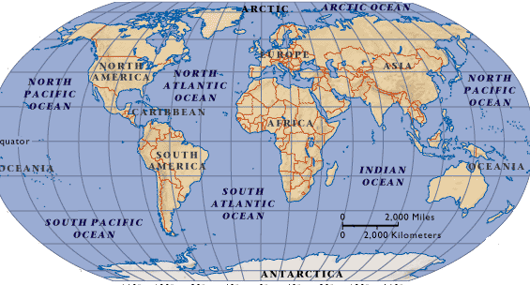

Slide 11
Formation of cyclone
Storms that originate in oceans or seas.
Formed when the sea temperature is 27⁰ or above
Air above the sea surface is heated and the warm moist air starts to rise.
A deep centre of low pressure develops
Wind speeds around the centre of the cyclone increase to 150 -200kph
Torrential rain falls from cumulo-nimbus cloud
Weather is calm and dry in the centre which is known as eye

Slide 12
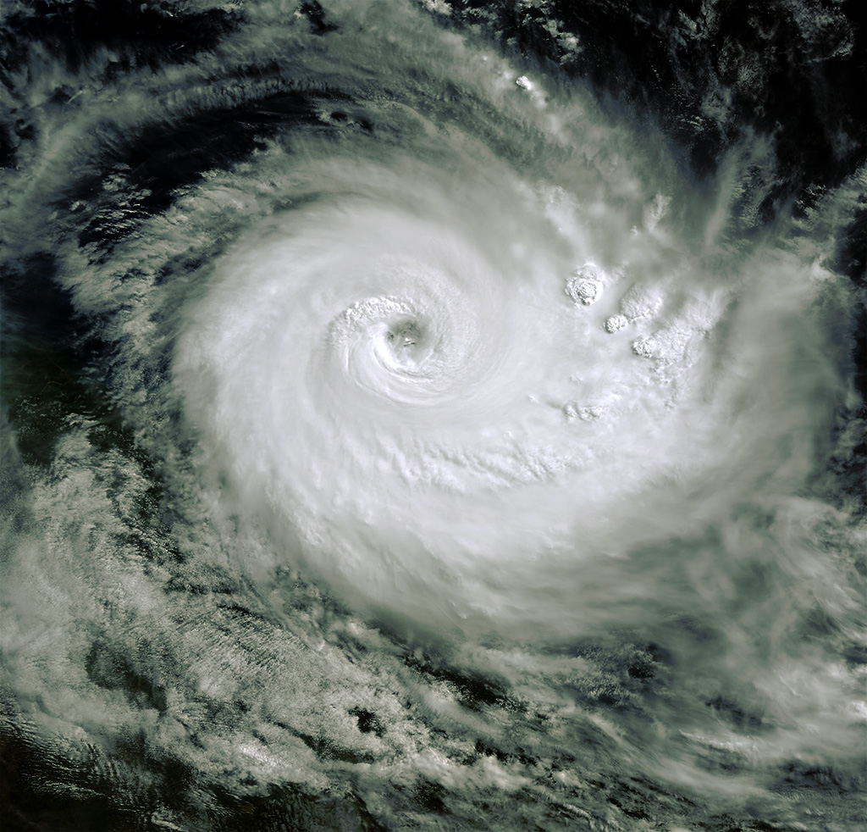
Cyclone

Slide 13
Tornado
Tornados are storm systems that form on land due to pressure differences. They are characterized by
- large rotating air columns, which are like funnels
- that are connected with clouds at the top and land below.
They move with phenomenal speeds, touching 300 mph on land before dissipating.
On a local scale, it is the most destructive of all atmospheric phenomena.

Slide 14
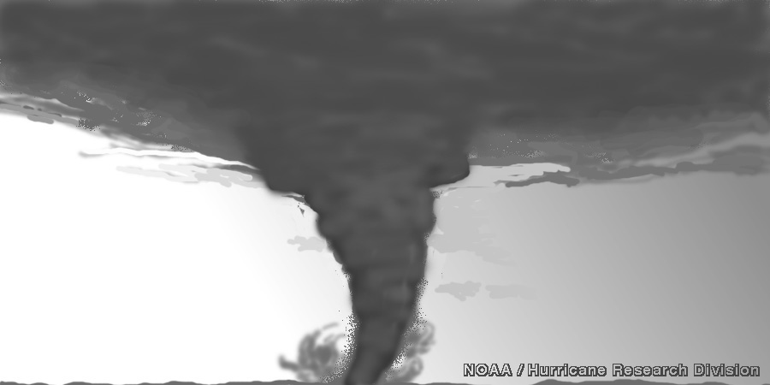

Slide 15
Cyclone Vs Tornado
Similarity – all storms are created due to severe differences in air pressure and caused due to temperature differences.
Difference – cyclones originate in the ocean and tornado on land.
- tornados are in contact with land at the bottom and cumuliform cloud at the top.

Slide 16
Impact of cyclone and tornado
Loss of life (social losses)
Economic losses
Damage of homes
Damage of business (loss of crops and animals of firms)
Public utility are badly disrupted
Disruption of fresh water supply, sewerage treatment, waste disposal
Increase of disease and epidemics

Slide 17
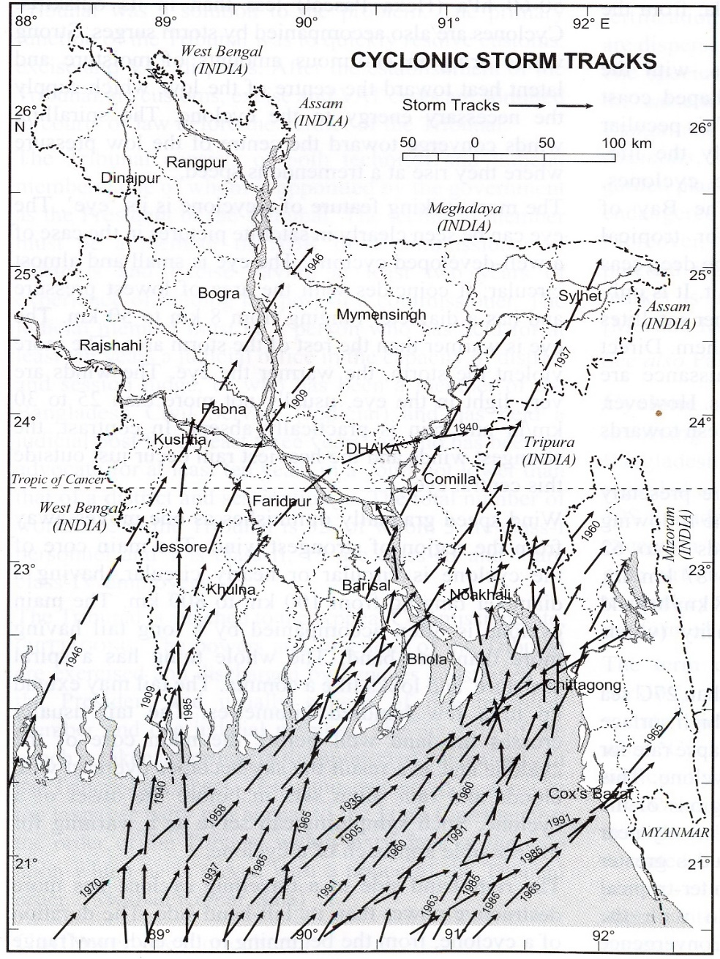
Cyclone Sidr was the strongest named cyclone in the Bay of Bengal that resulted into one of the worst natural disasters in Bangladesh
Total fatalities: 10,000
Date: November 2007
Affected areas: Bangladesh, India
SIDR’s
route
Entire coastal
belt is vulnerable
to Storm Surges
and Cyclones.

Slide 18
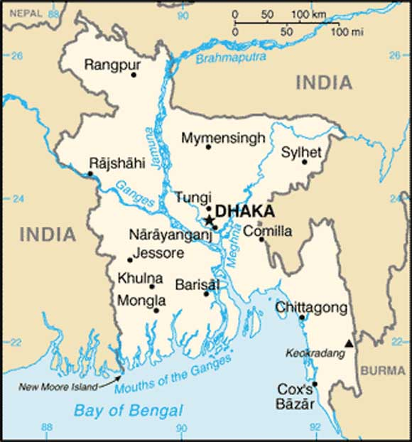
In 1970, 300,000 people died in a cyclone
1988 cyclone Death toll over 2,000
cyclone 1991 an estimated 140,000 deaths.

Slide 19
Flood
A flood is an overflow of water that submerges land that is usually dry. This is most commonly due to an overflowing river, a dam break, snowmelt, or heavy rainfall. Less commonly happening are tsunamis, storm surge.

Slide 20
Principal types of flood
Flooding can be divided into different categories according to their duration:
1. Slow-Onset Floods
Slow-Onset Floods usually last for a relatively longer period, it may last for one or more weeks, or even months. As this kind of flood last for a long period, it can lead to lose of stock, damage to agricultural products, roads and rail links.

Slide 21
2. Rapid-Onset Floods
Rapid-Onset Floods last for a relatively shorter period, they usually last for one or two days only. Although this kind of flood lasts for a shorter period, it can cause more damages and pose a greater risk to life and property as people usually have less time to take preventative action during rapid-onset floods.
3. Flash Floods
Flash Floods may occur within minutes or a few hours after heavy rainfall, tropical storm, failure of dams or releases of ice jams. And it causes the greatest damages to society.

Slide 22
Flooding can also be divided into different categories according to their location:
1. Coastal Floods
Coastal Floods usually occur along coastal areas. When there are hurricanes and tropical storms which will produce heavy rains, or giant tidal waves created by volcanoes or earthquakes, ocean water may be driven onto the coastal areas and cause coastal floods.
2. River Floods
This is the most common type of flooding. When the actual amount of river flow is larger than the amount that the channel can hold, river will overflow its banks and flood the areas alongside the river. And this may cause by reasons like snow melt or heavy rain.

Slide 23
3. Urban Floods In most of the urban area, roads are usually paved. With heavy rain, the large amount of rain water cannot be absorbed into the ground and leads to urban floods.

Slide 24
Effects of flood
Immediate/Short-term
Loss of human life
Destruction of houses, offices, factories and work places
Loss of livestock
Damages of crops
Damages of transportation and communication systems
Long-term
People become homeless
Suffering from water-related diseases
Shortage of safe drinking water and food
Problems of moving between places

Slide 25
Causes of flood in Bangladesh
Low general topography
Tropical monsoon climate
Heavy monsoon rainfall
Snow melt in the Himalayan mountain during summer
Rise in mean sea level during monsoon
Flood protecting embankments along big rivers in India
Rise of bed levels of big rivers due to sedimentation.
Construction of roads, railways and human settlements

Slide 26
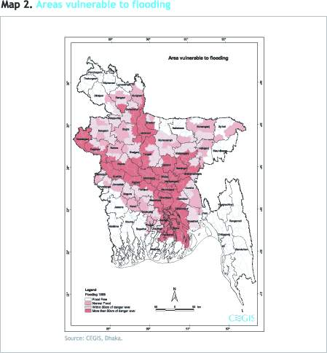
Vulnerability to Flooding

Slide 27
Drought
A drought is an extended period of months or years when a region notes a deficiency in its water supply. Generally, this occurs when a region receives consistently below average precipitation. It occurs when wind and pressure pattern are different from normal, so that expected rains do not fall.

Slide 28
Types of Drought
Meteorological Drought - Related to rainfall amounts.
- is generally defined by comparing the rainfall with the average rainfall for that place/region.
Agricultural Drought
- Related to availability of water to crops.
- When there is not enough water available for a particular crop to grow at a particular time.

Slide 29
Hydrological Drought
- Hydrological drought is associated with the effects of periods of precipitation shortages on water supply.
- Affects uses which depend on water levels.
Socioeconomic Drought Socioeconomic drought occurs when the demand for an economic good exceeds supply as a result of a weather-related shortfall in water supply.

Slide 30
Effects of Drought
- Damage to crop quality
- Food shortages - Increase in food prices - Increased importation of food (higher costs) - Income loss for farmers and others affected - Loss to recreational and tourism industry - Loss of hydroelectric power - Loss of navigability of rivers and canals.
- Increased desertification - Damage to animal species - Reduction and degradation of fish and wildlife habitat - Lack of feed and drinking water - Wind and water erosion of soils
-Political conflicts - Social unrest

Slide 31
Earthquake
An earthquake is the result of a sudden release of energy in the Earth's crust that creates seismic waves. The seismicity or seismic activity of an area refers to the frequency, type and size of earthquakes experienced over a period of time. Earthquakes are measured with a device which also records data is known as a seismograph. The time, locations, and magnitude of an earthquake can be determined from the data recorded by seismograph
Usually associated with faulting or breaking of rocks and movement of tectonic plates
Continuing adjustment of position results in aftershocks

Slide 32
Some basic terminology
Magnitude : measure of the strength or energy of an earthquake as determined from seismographic information.
Different scales are used ; most common is Richter scale
Introduced in 1935, the Richter scale is a numerical scale for quantifying earthquake magnitude;
Arabic (decimal) numbers are used e.g. 6.5;
open ended logarithmic scale; meaning that the numbers on the scale measure factors of 10. So, for example, an earthquake that measures 4.0 on the Richter scale is 10 times larger than one that measures 3.0.
maximum recorded 9.5 (Chile, 1960)
Intensity: a measure of the effects at a particular place produced by shaking during an earthquake.
intensity scale adopted in 1931 that divides the effects of an earthquake into twelve categories, from I (not felt by people) to XII (damage total).
Based on post-earthquake surveys

Slide 33
Some basic terminology
Hypocentre: This is the point of origin of earthquake.
Epicentre: The point on the Earth's surface directly above the point of origin (hypocentre or focus) of an earthquake
Point of maximum impact
only two measurements, latitude and longitude, are needed to locate it.

Slide 34
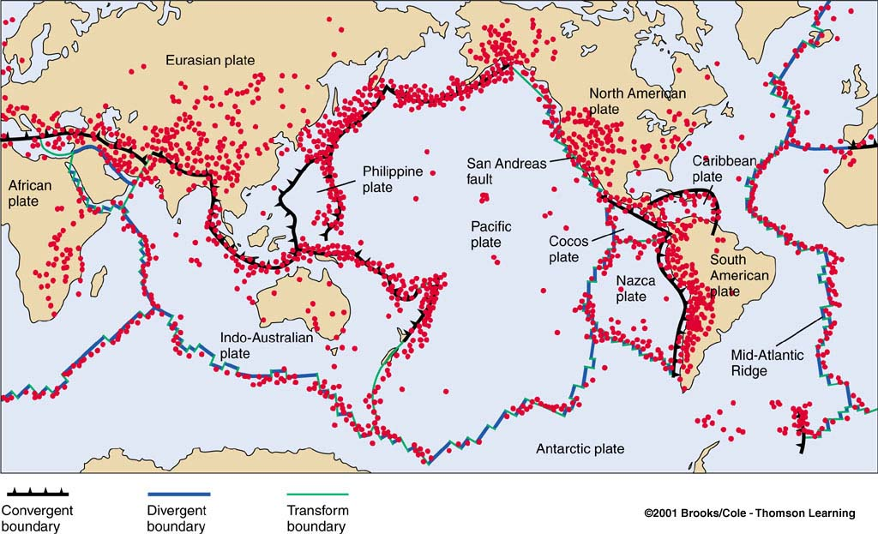
Where Do Earthquakes Occur and How Often?
~80% of all earthquakes occur in the circum-Pacific belt - most of these result from convergent margin activity
~15% occur in the Mediterranean-Asiatic belt
remaining 5% occur in the interiors of plates
more than 150,000 quakes strong enough to be felt are recorded each year

Slide 35
Effects of earthquakes
Shaking and ground rupture
Shaking and ground rupture are the main effects created by earthquakes, principally resulting in more or less severe damage to buildings and other rigid structures.
Landslides
Earthquakes, along with severe storms, volcanic activity, coastal wave attack, and wildfires, can produce slope instability leading to landslides, a major geological hazard.
Fires
Earthquakes can cause fires by damaging electric power or gas lines.

Slide 36
Continued..
Soil liquefaction
Soil liquefaction occurs when, because of the shaking, water-saturated granular material (such as sand) temporarily loses its strength and transforms from a solid to a liquid.
Tsunami
long sea waves produced by the sudden or abrupt movement of large volumes of water.

Slide 37
Strength of earthquake and possible effects
< 3.5: rarely felt by the people
3.6-4.9:often felt but rarely causes damages
5.0-5.9:damage and loss of life become possible
6.0-6.9:strong earthquakes, much damages and considerable loss of life are possible
7.0 & above: major earthquakes which can cause serious damage.

Slide 38
THANK YOU

